Slide 1
2-4 Conditional Probability
To introduce conditional probability, consider an example involving manufactured parts.
Let D denote the event that a part is defective and let F denote the event that a part has a surface flaw.
Then, we denote the probability of D given, or assuming, that a part has a surface flaw as P(D|F). This notation is read as the conditional probability of D given F, and it is interpreted as the probability that a part is defective, given that the part has a surface flaw.

Slide 2
2-4 Conditional Probability
Definition

Slide 5
2-5 Multiplication and Total Probability Rules
2-5.1 Multiplication Rule

Slide 6
2-5 Multiplication and Total Probability Rules
2-5.2 Total Probability Rule
Figure 2-15 Partitioning an event into two mutually exclusive subsets.
Figure 2-16 Partitioning an event into several mutually exclusive subsets.

Slide 7
2-5 Multiplication and Total Probability Rules
2-5.2 Total Probability Rule (two events)

Slide 8
2-5 Multiplication and Total Probability Rules
Total Probability Rule (multiple events)

Slide 12
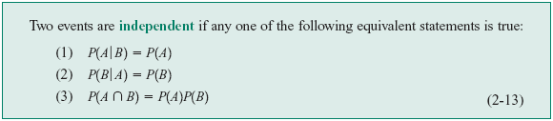
2-6 Independence
Definition (two events)

Slide 13
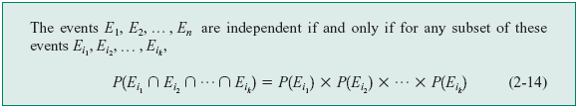
2-6 Independence
Definition (multiple events)

Slide 15
Example 2-34

Slide 17
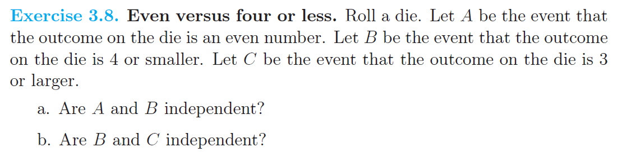

Slide 26
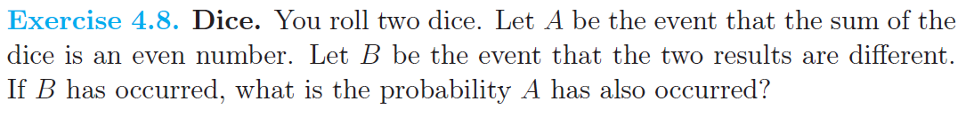

Slide 31
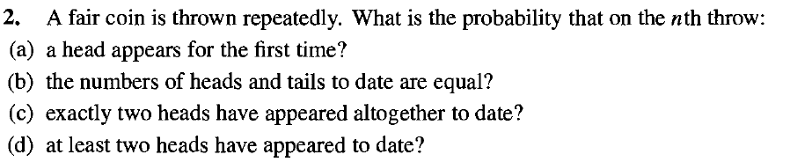

Slide 34
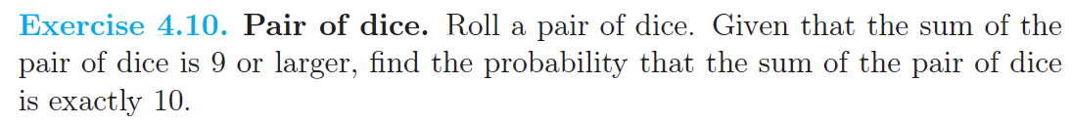

Slide 38
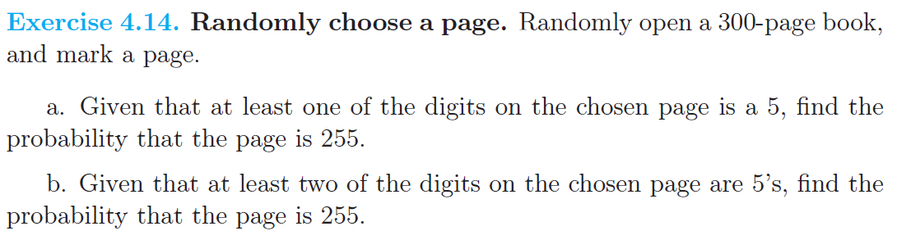

Slide 45
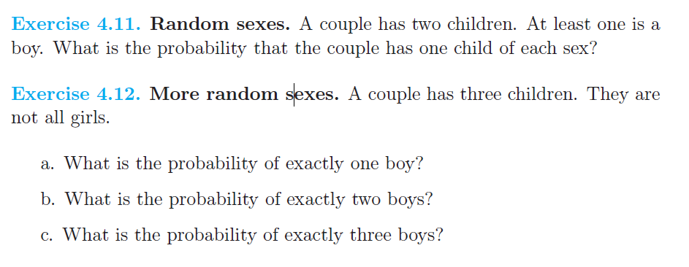

Slide 49
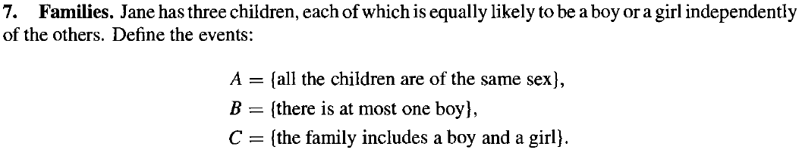

Slide 50
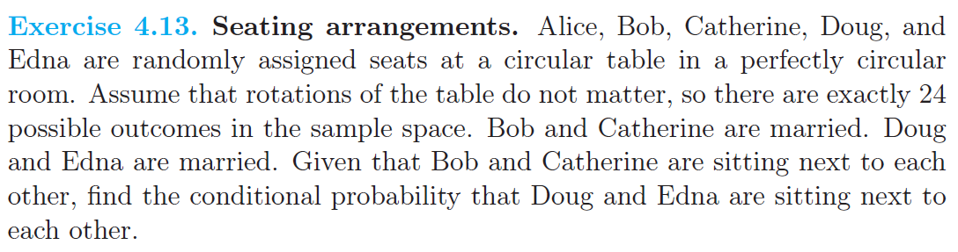

Slide 51

2-7 Bayes’ Theorem
Definition

Slide 52
2-7 Bayes’ Theorem
Bayes’ Theorem

Slide 53
2-8 Random Variables
Definition

Slide 54
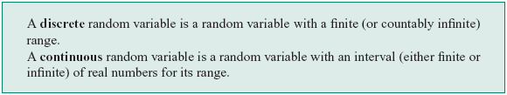
2-8 Random Variables
Definition

Slide 55
2-8 Random Variables
Examples of Random Variables

Slide 56
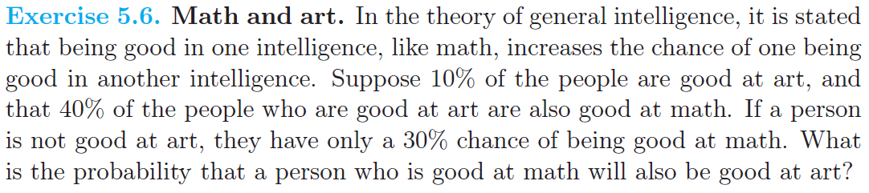

Slide 58
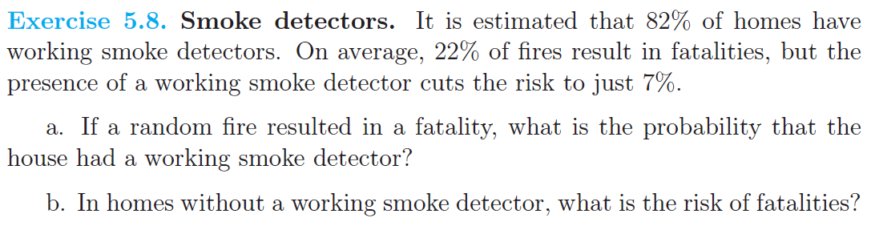

Slide 59
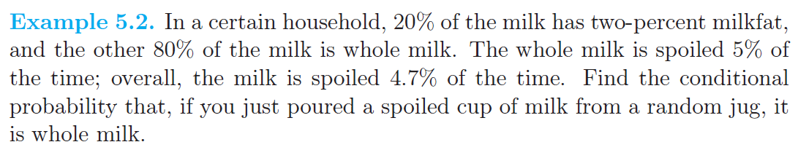

Slide 61
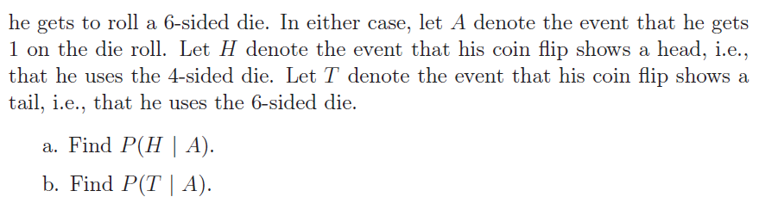

Slide 62
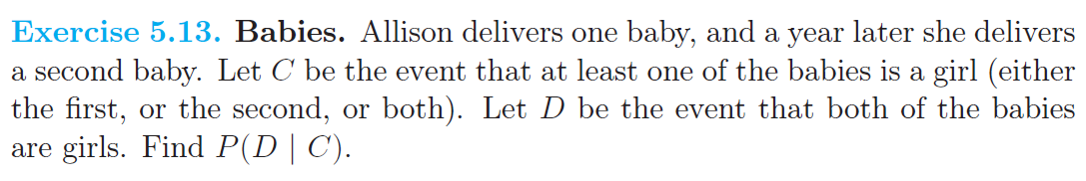

Slide 63
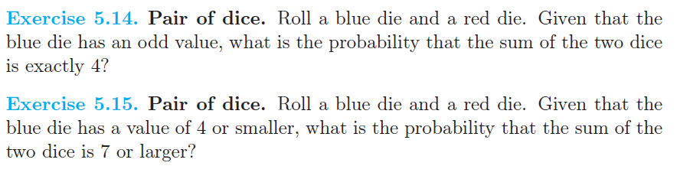

Slide 64
